Slide 1
Chapter 16 – Software Reuse
Lecture 1
Chapter 16 Software reuse

Slide 2
Chapter 16 – Software Reuse 软件重用
The reuse landscape (benefits and problems)
Application frameworks
Software product lines
COTS product reuse
软件复用的概要(好处和问题)
应用程序框架
软件产品线
COTS （商业现货）产品重用
Chapter 16 Software reuse

Slide 3
Software reuse软件复用
In most engineering disciplines, systems are designed by composing existing components that have been used in other systems.
Software engineering has been more focused on original development but it is now recognised that to achieve better software, more quickly and at lower cost, we need a design process that is based on systematic software reuse.
There has been a major switch to reuse-based development over the past 10 years.
Although reuse was proposed as a development strategy more than 40 years ago(McIlroy,1968),it is only since 2000 that ‘development with reuse’ has become the norm for new business systems.
在大多数工程学科,系统设计是通过组合现有组件,用于其他系统。
软件工程更加侧重于原始发展但现在认识到,为了达到更好的软件,更快更以较低的成本,我们需要一个设计过程,基于系统的软件重用。
过去的10年里基于复用的开发才得到了重要的发展。
尽管重用作为发展战略提出了40多年前(McIlroy,1968),但自2000年以来,开发和重用的新业务系统才成为常态。

Slide 4
Reuse-based software engineering
基于复用的软件工程
(1) Application system reuse
  The whole of an application system may be reused either by incorporating it without change into other systems (COTS reuse) or by developing application families.
(2) Component reuse
  Components of an application from sub-systems to single objects may be reused. Covered in Chapter 17.
(3) Object and function reuse
  Software components that implement a single well-defined object or function may be reused.
  (1)应用系统重用
  整个应用程序的系统可以被重用的将它没有改变到其他系统(COTS重用)或通过开发应用程序的家庭。
  (2)组件重用
  从子系统组件应用程序的单一对象可能被重用。在17章覆盖。
  (3)对象和功能的重用
  软件组件实现一个良好定义的对象或函数可能被重用。

Slide 5
Benefits of software reuse软件重用的好处
Benefit | Explanation
Increased dependability 增加可靠性——重用软件,经过试验和测试的工作系统,应该更可靠的比新软件。其设计和实现故障应该是发现和固定。 | Reused software, which has been tried and tested in working systems, should be more dependable than new software. Its design and implementation faults should have been found and fixed.
Reduced process risk 减少过程风险——现有软件的成本是已知的,而成本的发展总是一个判断的问题。这是项目管理的一个重要因素,因为它降低了项目成本估算的误差。尤其如此,当相对较大的子系统等软件组件重用。 | The cost of existing software is already known, whereas the costs of development are always a matter of judgment. This is an important factor for project management because it reduces the margin of error in project cost estimation. This is particularly true when relatively large software components such as subsystems are reused.
Effective use of specialists 有效利用专家——而不是一遍又一遍地做相同的工作,应用专家可以开发可重用软件,封装了他们的知识。 | Instead of doing the same work over and over again, application specialists can develop reusable software that encapsulates their knowledge.
Chapter 16 Software reuse

Slide 6
Benefits of software reuse
Benefit | Explanation
Standards compliance 标准一致性——一些标准,如用户界面标准,可以作为一组可重用的组件来实现。例如,如果用户界面中的菜单使用可重用的组件,实现所有应用程序相同的菜单格式呈现给用户。使用标准用户界面时提高了可靠性,因为用户犯更少的错误,一个熟悉的界面。 | Some standards, such as user interface standards, can be implemented as a set of reusable components. For example, if menus in a user interface are implemented using reusable components, all applications present the same menu formats to users. The use of standard user interfaces improves dependability because users make fewer mistakes when presented with a familiar interface.
Accelerated development 加速开发——尽可能早地为市场带来一个系统通常比整体开发成本更重要。重用软件可以加快系统由于开发和验证生产时间可能会减少。 | Bringing a system to market as early as possible is often more important than overall development costs. Reusing software can speed up system production because both development and validation time may be reduced.
Chapter 16 Software reuse

Slide 7
Problems with reuse 重用的问题
Problem | Explanation
Increased maintenance costs 增加维护成本——如果重用软件系统或组件的源代码不可用,那么维护成本可能更高,因为系统的重用元素可能越来越不兼容系统的变化。 | If the source code of a reused software system or component is not available then maintenance costs may be higher because the reused elements of the system may become increasingly incompatible with system changes.
Lack of tool support 缺乏工具支持——一些软件工具不支持开发和重用。它可能难以或者不可能与一个组件库系统整合这些工具。这些工具的软件过程假设可能不考虑重用。尤其适用于支持嵌入式系统工程的工具,那么面向对象开发工具。 | Some software tools do not support development with reuse. It may be difficult or impossible to integrate these tools with a component library system. The software process assumed by these tools may not take reuse into account. This is particularly true for tools that support embedded systems engineering, less so for object-oriented development tools.
Not-invented-here syndrome非我发明症（孤芳自赏）——一些软件工程师喜欢重写组件,因为他们相信他们可以改善。这部分是与信任和编写原始软件部分的事实被视为更具挑战性比重用其他例如€™s软件。 | Some software engineers prefer to rewrite components because they believe they can improve on them. This is partly to do with trust and partly to do with the fact that writing original software is seen as more challenging than reusing other people’s software.
Chapter 16 Software reuse

Slide 8
Problems with reuse
Problem | Explanation
Creating, maintaining, and using a component library 创建、维护和使用一个组件库 | Populating a reusable component library and ensuring the software developers can use this library can be expensive. Development processes have to be adapted to ensure that the library is used.填充一个可重用的组件库,保证软件开发人员可以使用这个库可以是昂贵的。开发过程必须适应确保使用图书馆。
Finding, understanding, and adapting reusable components 发现、理解和调整可重用的组件 | Software components have to be discovered in a library, understood and, sometimes, adapted to work in a new environment. Engineers must be reasonably confident of finding a component in the library before they include a component search as part of their normal development process.软件组件必须在图书馆里发现的,理解,有时,适应一个新的工作环境。工程师必须相当有信心找到一个组件在图书馆搜索包括组件之前正常的开发过程的一部分。
Software development processes have to be adapted to take reuse into account;
Software reuse is most effective when it is planned as part of an organization-wide reuse program.
  Importance of reuse planning in Japan: Matsumoto, 1984, Japanese ‘factory’ approach: Cusamano, 1989;
  Company:Hewlett-Packard(HP); Programs: Griss and Wosser, 1995
  软件开发过程必须适当的考虑重用;
  当软件作为全组织的重用程序的一部分被计划时，软件重用是有效率的 。
  重用计划在日本的重要性:松本,1984年,日本的“工厂”方法:Cusamano,1989;
  公司:惠普(HP);项目:偶联Wosser,1995
Chapter 16 Software reuse

Slide 9
16.1 The reuse landscape重用范围
Although reuse is often simply thought of as the reuse of system components, there are many different approaches to reuse that may be used.
Reuse is possible at a range of levels from simple functions to complete application systems.
The reuse landscape covers the range of possible reuse techniques.
Reuse techniques exploit the facts that systems in the same application domain are similar and have potential for reuse.
尽管重用通常被简单地认为是系统组件的重用,但重用有许多不同的方法
重用是可能在一定范围内用简单的函数 来 完成应用程序系统。
重用范围 覆盖可能重用技术的范围。
事实上 重用技术利用 系统在同一个应用程序域是相似的 和 有潜在的重用。

Slide 10
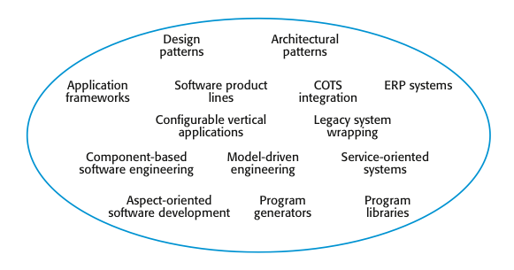
The reuse landscape
These reuse approaches are described briefly in the next three slides.
这些重用的方法简要描述在接下来的三个幻灯片。
Chapter 16 Software reuse

Slide 11
Approaches that support software reuse
支持软件重用的方法
Approach | Description
Architectural patterns 架构模式 | Standard software architectures that support common types of application systems are used as the basis of applications. Described in Chapters 6, 13, and 20. 标准的软件架构,支持常用类型的应用系统为基础的应用程序。章节中描述6、13和20。
Design patterns 设计模式 | Generic abstractions that occur across applications are represented as design patterns showing abstract and concrete objects and interactions. Described in Chapter 7. 发生跨应用程序的通用抽象表示为设计模式显示抽象和具体对象和交互。在第七章中描述。
Component-based development 基于组件的开发 | Systems are developed by integrating components (collections of objects) that conform to component-model standards. Described in Chapter 17.系统集成开发的组件(对象)的集合符合组件模型的标准。在第十七章中描述。
Application frameworks应用程序框架 | Collections of abstract and concrete classes are adapted and extended to create application systems. 集合的抽象和具体类是适应和扩展来创建应用程序系统。
Legacy system wrapping 遗留系统封装 | Legacy systems (see Chapter 9) are ‘wrapped’ by defining a set of interfaces and providing access to these legacy systems through these interfaces. 遗留系统(见第9章)是一个”有包装的”通过定义一组接口,通过这些接口提供这些遗留系统。
Chapter 16 Software reuse

Slide 12
Approaches that support software reuse
支持软件重用的方法
Approach | Description
Service-oriented systems 面向服务的系统 | Systems are developed by linking shared services, which may be externally provided. Described in Chapter 19.系统是由连接共享服务,可能是外部提供。在19章描述。
Software product lines 软件产品线 | An application type is generalized around a common architecture so that it can be adapted for different customers.应用程序类型是广义围绕一个通用的体系结构,它可以适应不同的客户。
COTS product reuse 商业现货产品重用 | Systems are developed by configuring and integrating existing application systems.开发的系统配置和集成现有应用系统。
ERP systems ERP系统 | Large-scale systems that encapsulate generic business functionality and rules are configured for an organization.大规模系统封装通用业务功能和规则被配置为一个组织。
Configurable vertical applications 可配置的垂直应用程序 | Generic systems are designed so that they can be configured to the needs of specific system customers.通用的系统设计,使他们可以配置为特定系统客户的需求。
Chapter 16 Software reuse

Slide 13
Approaches that support software reuse
支持软件重用的方法
Approach | Description
Program libraries 程序库 | Class and function libraries that implement commonly used abstractions are available for reuse.类和函数库实现常用的抽象可重用。
Model-driven engineering模型驱动工程 | Software is represented as domain models and implementation independent models and code is generated from these models. Described in Chapter 5.软件是表示为领域模型和实现从这些模型独立的模型和代码生成。在第五章中描述。
Program generators程序生成器 | A generator system embeds knowledge of a type of application and is used to generate systems in that domain from a user-supplied system model.发电机系统的嵌入知识类型的应用程序和用于生成系统域从用户提供的系统模型。
Aspect-oriented software development 面向方面的软件开发 | Shared components are woven into an application at different places when the program is compiled. Described in Chapter 21.共享组件已经融入应用程序在不同的地方当程序被编译。在21章描述。
Chapter 16 Software reuse

Slide 14
Reuse planning factors复用规划因素
Six Key factors:
  (1) The development schedule for the software.
  (2) The expected software lifetime.
  (3) The background, skills and experience of the development team.
  (4) The criticality of the software and its non-functional requirements.
  (5) The application domain.
  (6) The execution platform for the software. E.g. .NET is specific to Microsoft platforms.
Whether or not reuse is achieved is often a managerial rather than a technical issue. Managers may be unwilling to compromise their requirements to allow reusable components to be used.
Although the risks of new software development may be higher, some managers may prefer known to unknown risks.
Chapter 16 Software reuse

Slide 15
Reuse planning factors重用规划因素
6个关键因素:
(1)软件的开发进度。
(2)预期的软件生命周期。
(3)背景,技能和经验的开发团队。
(4)软件的临界和非功能性需求。
(5)应用程序 领域。
(6)软件的执行平台。例如。网络是特定于微软平台。
是否重用实现通常是管理问题,而不是一个技术问题。管理者可能不愿意妥协他们的需求,去允许使用可重用的组件。
虽然新的软件开发的风险可能会更高, 一些管理者比起未知的风险更倾向于已知的风险。
Chapter 16 Software reuse

Slide 16
16.2 Application frameworks应用框架
Frameworks are moderately large entities that can be reused. They are somewhere between system and component reuse.
Frameworks are a sub-system design made up of a collection of abstract and concrete classes and the interfaces between them.
The sub-system is implemented by adding components to fill in parts of the design and by instantiating the abstract classes in the framework.
框架是比较大的实体,可以重用。他们是介于系统和组件重用之间的。
框架是一个由抽象和具体的集合类和它们之间的接口组成的子系统设计。
子系统通过添加组件来填写的部分设计来实现和被实例化的抽象类框架。
Chapter 16 Software reuse

Slide 17
Framework classes框架分类
(1) System infrastructure frameworks
  Support the development of system infrastructures such as communications, user interfaces and compilers.
(2) Middleware integration frameworks
  Standards and classes that support component communication and information exchange(e.g. ,MS. :.NET, Java: EJB).
(3) Enterprise application frameworks
  Support the development of specific types of application such as telecommunications or financial systems.
  (1)系统基础架构框架
  支持系统等基础设施通信的发展,用户界面和编译器。
  (2)中间件的集成框架
  标准和类,支持组件的通信和信息交换(如。,女士。:。净,Java:EJB)。
  (3)企业应用程序框架
  支持发展特定类型的应用程序例如电信或金融系统。
Chapter 16 Software reuse

Slide 18
Web application frameworks Web应用框架
Support the construction of dynamic websites as a front-end for web applications.
WAFs are now available for all of the commonly used web programming languages e.g. Java, Python, Ruby, etc.
Interaction model(The architecture of a WAF) is based on the Model-View-Controller composite pattern.
支持动态网站的创建，作为web应用程序的前端。
现在WAF所有常用的web编程语言都可以用 如Java、Python、Ruby等等。
交互模型(WAF的体系结构）是基于模型-视图-控制器MVC复合模式。
Chapter 16 Software reuse

Slide 19
Model-view controller MVC模型-视图控制器
The MVC pattern was originally proposed in the 1980s as an approach to GUI design that allowed for multiple presentations of an object and separate styles of interaction with each of these presentations.
A MVC framework supports the presentation of data in different ways and allows interaction with each of these presentations.
MVC framework involves the instantiation of a number of patterns (as discussed in Chapter 7), including: the Observer pattern, Strategy pattern, the Composition pattern, etc.
MVC模式最初在1980年代提出的GUI(图形用户结构)设计方法, allowed for multiple presentations of an object and separate styles of interaction with each of these presentations.
MVC框架以不同的方式数据业务 而且允许它们交互。
MVC框架涉及到实例化的模式(如第七章中讨论),包括:观察者模式,策略模式,组合模式,等等。

Slide 20
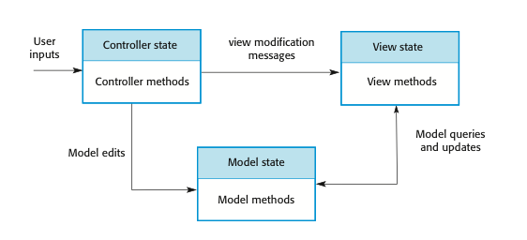
The Model-View-Controller pattern
模型-视图控制器模式MVC
Chapter 16 Software reuse

Slide 21
WAF features(Web Application frameworks)
Web应用框架特点
Most Web application frameworks support the following features:
(1) Security. WAFs may include classes to help implement user authentication (login) and access.
(2) Dynamic web pages. Classes are provided to help you define web page templates and to populate these dynamically with specific data from the system database.
(3) Database support. The framework may provide classes that provide an abstract interface to different databases.
(4) Session management. Classes to create and manage sessions (a number of interactions with the system by a user) are usually part of a WAF.
(5) User interaction. Most web frameworks now provide AJAX support (Holdener, 2008), which allows more interactive web pages to be created.
大多数Web应用程序框架支持以下特性:
(1)安全。waf可能包括类来帮助实现用户身份验证和访问(登录)。
(2)动态网页。类提供了帮助您定义web页面模板和填充这些动态与特定的数据从系统数据库中。
(3)数据库支持。该框架可以提供不同的数据库类,提供一个抽象的接口。
(4)会话管理。类来创建和管理会议(由用户与系统交互的数量)通常WAF的一部分。
(5)用户交互。现在大多数web框架提供AJAX支持(霍尔顿,2008),它允许更要创建交互式网页。
Chapter 16 Software reuse

Slide 22
Extending frameworks扩展框架
Frameworks are generic and are extended to create a more specific application or sub-system. They provide a skeleton architecture for the system.
Extending the framework involves
  Adding concrete classes that inherit operations from abstract classes in the framework;
  Defining callback methods that are called in response to events that are recognised by the framework.
Problem with frameworks is their complexity which means that it takes a long time to use them effectively.
框架都是通用的, 扩展来创建一个更具体的应用程序或子系统。他们为系统提供了一个大概的框架。
扩展框架包括
添加具体类----从框架的抽象类继承操作;
定义回调方法----称为响应事件所认可的框架。
框架的问题是 它们的复杂性意味着 它需要很长时间来有效地使用它们。

Slide 23
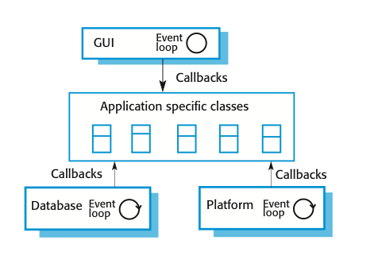
‘Inversion of control’ in frameworks
“控制反转”框架
‘Callbacks’ are methods that are called in response to events recognized by the framework.
The framework objects are responsible for control in the system, they invoke ‘hook methods’.
The application-specific functionality responses to the event in an appropriate way.
Frameworks are usually more general than software product lines, which focus on a specific family of application system.
“回调”的方法被称为响应事件认可的框架。
框架对象负责控制系统中,它们调用“钩方法”。
特定于应用程序的功能对事件的反应在一个适当的方式。
框架通常比软件更一般的产品线,专注于一个具体的应用系统的家庭。
Chapter 16 Software reuse

Slide 24
Key points
Most new business software systems are now developed by reusing knowledge and code from previously implemented systems.
There are many different ways to reuse software. These range from the reuse of classes and methods in libraries to the reuse of complete application systems.
The advantages of software reuse are lower costs, faster software development and lower risks. System dependability is increased. Specialists can be used more effectively by concentrating their expertise on the design of reusable components.
Application frameworks are collections of concrete and abstract objects that are designed for reuse through specialization and the addition of new objects. They usually incorporate good design practice through design patterns.
现在大部分新业务软件系统开发的重用从先前知识和代码实现系统。
有许多不同的方法来重用软件。这些范围从类和方法的复用到直接复用一个完整的应用系统
软件重用的优点是更低的成本、更快的软件开发和降低风险。系统可靠性增加。设计复用组件时，专家可以更有效地使用他们的专业知识 。
应用程序框架的具体和抽象对象 通过 专业化和设计重用的新对象。他们通常通过设计模式进行好的设计实践。
Chapter 16 Software reuse

Slide 25
Chapter 16 – Software Reuse
Lecture 2
Chapter 16 Software reuse

Slide 26
16.3 Software product lines软件生产线
Software product lines or application families are applications with generic functionality that can be adapted and configured for use in a specific context.
A software product line is a set of applications with a common architecture and shared components, with each application specialized to reflect different requirements. （定义）
Adaptation may involve:
  Component and system configuration;
  Adding new components to the system;
  Selecting from a library of existing components;
  Modifying components to meet new requirements.
  软件产品线或应用族 应用通用的功能，在一个特定的上下文可以适应和配置为使用。
适应可能包括:
  组件和系统配置;
  将新组件添加到系统;
  选择从一个现有的组件库;
  修改组件以满足新的需求。

Slide 27
Application frameworks and product lines
应用程序框架 和 产品线
Application frameworks rely on object-oriented features such as polymorphism to implement extensions. Product lines need not be object-oriented (e.g. embedded software for a mobile phone)
Application frameworks focus on providing technical rather than domain-specific support. Product lines embed domain and platform information.
Product lines often control applications for equipment.
Software product lines are made up of a family of applications, usually owned by the same organization.
应用程序框架依赖于面向对象的多态等特性来实现扩展。产品线不需要面向对象(例如手机嵌入式软件)
应用程序框架关注提供技术,而不是特定域的支持。产品线嵌入域和信息平台。
生产线经常控制设备的引用。
软件产品线是由一个应用族组成,通常属于同一组织。
Chapter 16 Software reuse

Slide 28
Product line specialisation
产品线专业化
Platform specialization平台的专业化
  Different versions of the application are developed for different platforms. E.g., versions of the application may exist for Windows, Mac OS, and Linux platforms.
Environment specialization环境的专业化
  Different versions of the application are created to handle different operating environments, e.g. different types of communication equipment. E.g., a system for the emergency services may exist in different versions, depending on the vehicle communications system.
Functional specialization功能的专业化
  Different versions of the application are created for customers with different requirements. E.g., a library automation system may be modified depending on whether it is used in a public library, a reference library, or a university library.
Process specialization过程的专业化
  Different versions of the application are created to support different business processes. E.g., an ordering system may be centralized or distributed.

Slide 29
Product line architectures
产品线体系结构
Architectures must be structured in such a way to separate different sub-systems and to allow them to be modified.
The architecture should also separate entities and their descriptions, and the higher levels in the system access entities through descriptions rather than directly.
架构必须结构化的方式来分离不同的子系统,并允许他们被修改。
体系结构还应该分离实体和他们的描述,系统中更高水平通过描述访问实体而不是直接访问实体。

Slide 30
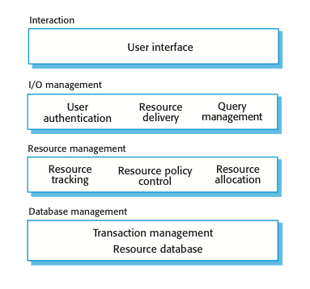
The architecture of a resource allocation system
资源分配系统的体系结构
This four-layer structure is instantiated in next slide.
这个四层结构在下一页ppt中实例化了
Chapter 16 Software reuse

Slide 31
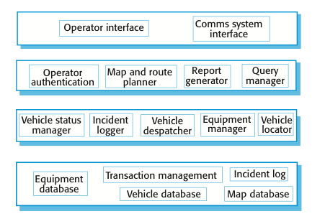
The product line architecture of a vehicle dispatcher车辆调度的产品线体系结构
This Figure shows the modules that might be included in a vehicle despatching system product line.
这图显示了模块中可能包含车辆调度系统产品线。
Chapter 16 Software reuse

Slide 32
Vehicle dispatching车辆调度
A specialised resource management system where the aim is to allocate resources (vehicles) to handle incidents.
Adaptations(The components at each level) include:
  At the UI level, there are components for operator display and communications;
  At the I/O management level, there are components that handle authentication, reporting and route planning;
  At the resource management level, there are components for vehicle location and despatch, managing vehicle status and incident logging;
  At the database level, as well as the usual transaction management support, there are separate databases of equipment, vehicles and maps.
  专门的资源管理系统的目的是 分配资源(车辆)来处理事件。
  适应(每一层的组件)包括:
  在UI层, 有组件操作符显示和通信;
  I / O管理层, 有组件处理身份验证、报告和路线规划;
  在资源管理层面, 有汽车零部件位置和派遣,管理车辆状态和事件日志记录;
  在数据库层, 以及常用的事务管理支持,有单独的数据库设备、车辆和地图。

Slide 33
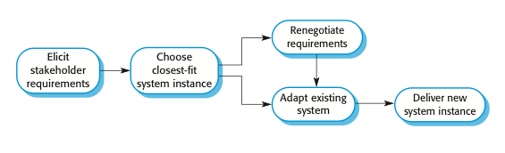
Product instance development产品实例开发
The steps involved in extending a software product line to create a new application, more details in next slide.
步骤涉及扩展软件产品线，来创建一个新的应用程序,更多的细节在下个幻灯片。
Chapter 16 Software reuse

Slide 34
Product instance development
(1) Elicit stakeholder requirements
  Use existing family member as a prototype.
(2) Choose closest-fit family member
  Find the family member that best meets the requirements.
(3) Re-negotiate requirements
  Adapt requirements as necessary to capabilities of the software.
(4) Adapt existing system
  Develop new modules and make changes for family member.
(5) Deliver new family member
  The new instance of the product line is delivered to the customer. You should document key features for further member development.

Slide 35
产品实例开发
(1)引出涉众的需求
使用现有的应用族成员作为一个原型。
(2)选择最接近的家庭成员
找到最能满足需求的家庭成员。
(3)就要求重开谈判
适应需求的必要功能软件。
(4)适应现有的系统
开发新的模块和对家庭成员进行更改。
(5)提供新的家庭成员
新生产线的实例传递给客户。你应该开发文档关键特性进行进一步的成员。
Chapter 16 Software reuse

Slide 36
Product line configuration产品生产线配置
Software product lines are designed to be reconfigured and this reconfiguration may involve adding or removing components from the system, defining parameters and constraints for system components, and including knowledge of business processes.
This configuration may occur at different stages in the development process:
(1) Design time configuration
  The product line is adapted and changed according to the requirements of particular customers.
(2) Deployment time configuration
  The product line is configured by embedding knowledge of the customer’s requirements and business processes. The software source code itself is not changed.
  软件产品线是为了重新配置而设计，这种重新配置可能需要从系统中添加或删除组件,为系统组件定义参数和约束,包括业务流程的知识。
  此配置可能发生在开发过程的不同阶段:
  (1)设计时配置
  产品线是适应和改变根据客户特定的需求。
  (2)部署时配置
  的产品线配置嵌入客户的需求和业务流程的知识。软件源代码本身是没有改变的。

Slide 37
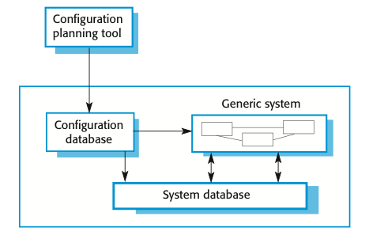
Deployment-time configuration部署时配置
Deployment-time configuration involves using a configuration tool to create a specific system configuration that is recorded in a configuration database or as a set of configuration files.
The executing system consults this database when executing so that its functionality may be specialized to its execution context.
部署时的配置需要使用配置工具来创建一个特定的系统配置,都记录在一个配置数据库或作为一组配置文件。
执行系统查询该数据库在执行,其功能可能是专门执行上下文。
Chapter 16 Software reuse

Slide 38
Levels of deployment time configuration
部署时的配置—分级
There are several levels of deployment-time configuration that may be provided in a system:
(1) Component selection, where you select the modules in a system that provide the required functionality.
(2) Workflow and rule definition, where you define workflows (how information is processed, stage-by-stage) and validation rules that should apply to information entered by users or generated by the system.
(3) Parameter definition, where you specify the values of specific system parameters that reflect the instance of the application that you are creating.
系统可能提供几个级别的部署时配置
(1)组件选择, 你选择的模块系统,提供所需的功能。
(2)工作流和规则定义, 定义工作流(如何处理信息,分阶段)和验证规则,应该适用于用户输入的信息,或由系统生成。
(3)参数定义, 您指定特定系统参数的值,以反映您正在创建的应用程序的实例。
Chapter 16 Software reuse

Slide 39
16.4 COTS product reuse
COTS商业现货产品重用
  A commercial-off-the-shelf (COTS) product is a software system that can be adapted for different customers without changing the source code of the system.
  COTS systems have generic features and so can be used/reused in different environments.
  COTS products are adapted by using built-in configuration mechanisms that allow the functionality of the system to be tailored to specific customer needs.
    For example, in a hospital patient record system, separate input forms and output reports might be defined for different types of patient.
    一个商用现货(COTS)产品是一种软件系统,在不改变系统的源代码情况下，可以适应不同的客户。
    COTS系统通用功能,所以可以使用/重用在不同的环境中。
    COTS产品适应通过使用内置的配置机制,使系统的功能是根据特定客户的需求。
    例如,在医院的病人记录系统,区分开的的输入和输出形式报告可能被定义为不同类型的病人。
Chapter 16 Software reuse

Slide 40
Benefits of COTS reuse
COTS复用的好处
This approach to software reuse has been very widely adopted by large companies over the last 15 or so years, as it offers significant benefits over customized software development:
(1) As with other types of reuse, more rapid deployment of a reliable system may be possible.
(2) It is possible to see what functionality is provided by the applications and so it is easier to judge whether or not they are likely to be suitable.
(3) Some development risks are avoided by using existing software. However, this approach has its own risks, as I discuss below.
(4) Businesses can focus on their core activity without having to devote a lot of resources to IT systems development.
(5) As operating platforms evolve, technology updates may be simplified as these are the responsibility of the COTS product vendor rather than the customer.
这种软件重用方法非常广泛采用大型企业在过去的15年,因为它在定制的软件开发提供了显著的好处:
(1)与其他类型的重用,快速部署的一个可靠的系统成为可能。
(2)可以看到应用程序所提供的功能,所以它更容易判断他们是否可能是合适的。
(3)一些开发风险是避免通过使用现有的软件。然而,这种方法有其自身的风险,我在下面讨论。
(4)企业可以专注于他们的核心活动,无需投入大量资源系统开发。
(5)随着操作平台的发展,技术的更新可以简化这些COTS产品供应商的责任,而不是顾客。
Chapter 16 Software reuse

Slide 41
Problems of COTS reuse
COTS重用的问题
Of course, this approach to software engineering has its own problems:
(1) Requirements usually have to be adapted to reflect the functionality and mode of operation of the COTS product. This can lead to disruptive changes to existing business processes.
(2) The COTS product may be based on assumptions that are practically impossible to change. The customer must therefore adapt their business to reflect these assumptions.
(3) Choosing the right COTS system for an enterprise can be a difficult process, especially as many COTS products are not well documented.
(4) There may be a lack of local expertise to support systems development.
(5) The COTS product vendor controls system support and evolution.
当然,这种方法对软件工程有其自身的问题:
(1)需求通常必须适应反映COTS产品的功能和操作方式。这可能会导致破坏性的改变现有的业务流程。
(2)COTS产品可能是基于假设改变几乎是不可能的。因此,客户必须调整其业务,以反映这些假设。
(3)为企业选择正确的COTS系统可能是一个艰难的过程,尤其是当许多COTS产品并不良好的文档记录。
(4)可能存在缺乏本地技术支持系统开发。
(5)COTS产品供应商控制系统支持和演化。
Chapter 16 Software reuse

Slide 42
COTS-solution and COTS-integrated systems
COTS的两种系统
There are two types of COTS product reuse, namely COTS-solution systems and COTS-integrated systems:
有两种类型的COTS产品重用,即COTS-solution系统和COTS-integrated系统:
COTS-solution systems | COTS-integrated systems
Single product that provides the functionality required by a customer提供客户所需的功能的单一产品 | Several heterogeneous system products are integrated to provide customized functionality多个异构系统产品集成提供定制的功能
Based around a generic solution and standardized processes基于一个通用的解决方案和标准化的流程 | Flexible solutions may be developed for customer processes灵活的解决方案可以为客户开发的流程
Development focus is on system configuration发展重点是系统配置 | Development focus is on system integration发展重点是系统集成
System vendor is responsible for maintenance 系统供应商负责维护 | System owner is responsible for maintenance系统所有者负责维护
System vendor provides the platform for the system 系统供应商提供的平台系统 | System owner provides the platform for the system系统所有者提供了平台系统
Chapter 16 Software reuse

Slide 43
16.4.1 COTS solution systems
COTS-solution系统
COTS-solution systems are generic application systems that may be designed to support a particular business type, business activity or, sometimes, a complete business enterprise.
  For example, a COTS-solution system may be produced for dentists that handles appointments, dental records, patient recall, etc.
Domain-specific COTS-solution systems, such as systems to support a business function (e.g. document management) provide functionality that is likely to be required by a range of potential users.
  For example, a system to support student registration in a university may assume that students will be registered for one degree at one university. However, if universities collaborate to offer joint degrees, then it may be practically impossible to represent this in the system.
COTS-solution系统通用应用程序系统,可以用来支持特定的业务类型、业务活动或,有时,一个完整的企业。
例如,COTS-solution系统 可能生产出对于牙医的预约牙医,牙医记录,病人回忆等功能。
特定领域COTS-solution系统,如系统支持的业务功能(例如,文档管理)提供所需的功能,可能是一系列的潜在用户。
例如,一个系统, 可能在大学学生注册假设学生将注册一个大学学位。然而,如果大学合作提供联合学位,那么它可能代表系统中这几乎不可能的。
Chapter 16 Software reuse

Slide 44
ERP systems
Enterprise Resource Planning企业资源规划系统
An Enterprise Resource Planning (ERP) system is a generic system that supports common business processes such as ordering and invoicing, inventory management, and manufacturing scheduling, etc.
These are very widely used in large companies - they represent probably the most common form of software reuse.
The generic core is adapted by including modules and by incorporating knowledge of business processes and rules.
企业资源规划(ERP)系统是一个通用的系统,支持常见的订单和发票等业务流程,库存管理和生产调度等。
这些都是非常广泛应用于大型企业——他们可能是最常见的软件重用。
通用核心是适应包括模块和业务流程的整合知识和规则。

Slide 45
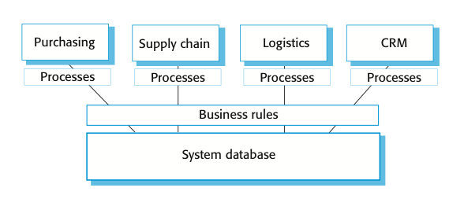
The architecture of an ERP system
ERP系统的体系结构
  A model of the overall architecture of an ERP system that supports a range of business functions is shown in the following:
  ERP系统的总体架构的模型,支持各种业务功能如下所示:
Chapter 16 Software reuse

Slide 46
ERP architecture
ERP的主要特点
The key features of the above ERP architecture are:
(1) A number of modules to support different business functions.
(2) A defined set of business processes, associated with each module, which relate to activities in that module.
(3) A common database that maintains information about all related business functions.
(4) A set of business rules that apply to all data in the database.
上面的ERP体系结构的主要特点是:
(1)大量模块来支持不同的业务功能。
(2)定义的业务流程,每个模块,在该模块联系了活动。
(3)一种常见的数据库,维护所有相关业务功能的信息。
(4)一组业务规则,适用于所有数据在数据库中。
Chapter 16 Software reuse

Slide 47
ERP configuration
ERP系统配置
Selecting the required functionality from the system.
Establishing a data model that defines how the organization’s data will be structured in the system database.
Defining business rules that apply to that data.
Defining the expected interactions with external systems.
Designing the input forms and the output reports generated by the system.
Designing new business processes that conform to the underlying process model supported by the system.
Setting parameters that define how the system is deployed on its underlying platform.
从系统中选择所需要的功能。
建立了一个数据模型,定义了如何组织的数据库系统中的数据将结构化。
定义业务规则,适用于数据。
定义预期的与外部系统的交互。
设计输入表单和报告由系统生成的输出。
设计新的业务流程符合底层系统支持的流程模型。
设置参数,它定义了系统部署在它的底层平台。
Chapter 16 Software reuse

Slide 48
16.4.2 COTS integrated systems
COTS （商业现货）集成系统
COTS-integrated systems are applications that include two or more COTS products and/or legacy application systems.
You may use this approach when there is no single COTS system that meets all of your needs or when you wish to integrate a new COTS product with systems that you already use.
COTS-integrated系统应用程序包括两个或两个以上的COTS产品和/或遗留应用程序系统。
没有单一的COTS系统时，你可以用这种方法,当您希望将新的COTS产品与你已经在使用的系统集成,满足你所有的需要。
Chapter 16 Software reuse

Slide 49
Design choices设计选择
To develop systems using COTS products, you have to make a number of design choices:
(1) Which COTS products offer the most appropriate functionality?
  Typically, there will be several COTS products available, which can be combined in different ways(experience is important).
(2) How will data be exchanged?
  Different products normally use unique data structures and formats. You have to write adaptors that convert from one representation to another.
(3) What features of a product will actually be used?
  COTS products may include more functionality than you need and functionality may be duplicated across different products.
  使用COTS产品开发系统,你必须做出一些设计的选择:
  (1)COTS产品提供最合适的功能吗?
  通常情况下,将会有几COTS产品可用,可以以不同的方式组合(经验是重要的)。
  (2)如何将数据交换?
  不同的产品通常使用独特的数据结构和格式。你必须编写适配器,转换到另一个从一个表示。
  (3)产品的哪些特性会被使用?
  COTS产品可能包括更多的功能比你需要和功能可能会重复在不同的产品。
Chapter 16 Software reuse

Slide 50
失败的阿丽亚娜5火箭
  If possible, you should also deny access to unused functionality because this can interfere with normal system operation. Ariane 5 rocket, 1997)
The failure of the first flight of the Ariane 5 rocket(Nuseibeh, 1997) was a consequence of a failure in an inertial navigation system that was reused from the Ariane 4 system. However, the functionality that failed was not actually required in Ariane 5.
如果可能的话,你也应该拒绝访问未使用的功能,因为这可能会干扰正常的系统操作。阿丽亚娜5型火箭发射,1997)
失败的阿丽亚娜5火箭的首飞(Nuseibeh,1997)是一个失败的结果在一个惯性导航系统从阿里安4系统重用。然而,失败的功能没有实际需要阿丽亚娜5。

Slide 51
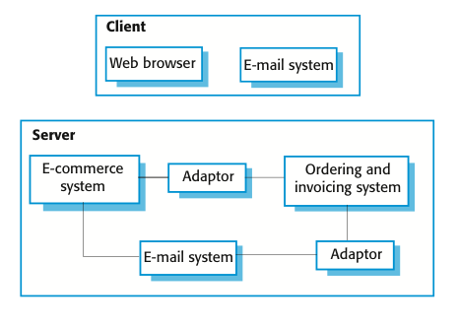
A COTS-integrated procurement system
COTS集成采购系统
Chapter 16 Software reuse

Slide 52
Service-oriented COTS interfaces
面向服务的COTS接口
COTS integration can be simplified if a service-oriented approach is used.
A service-oriented approach means allowing access to the application system’s functionality through a standard service interface, with a service for each discrete unit of functionality.
Some applications may offer a service interface but, sometimes, this service interface has to be implemented by the system integrator. You have to program a wrapper that hides the application and provides externally visible services(Figure in next slide).
如果使用面向服务的方法 ，COTS集成可以简化。
面向服务的方法意味着允许访问应用系统的功能通过一个标准的服务接口,为每个离散单元的功能与服务。
一些应用程序可能提供了一个服务接口,但有时,该服务接口必须实现的系统集成商。你必须计划一个隐藏应用程序的包装器,并提供外部可见的服务下一个幻灯片(图)。
Chapter 16 Software reuse

Slide 53
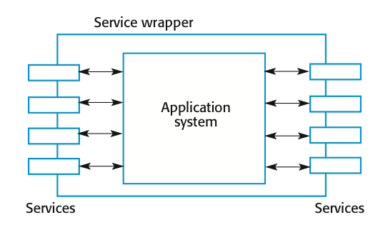
Application wrapping
应用程序封装
Chapter 16 Software reuse

Slide 54
COTS system integration problems
COTS系统集成问题
Four important COTS system integration problems:
(1) Lack of control over functionality and performance
  COTS systems may be less effective than they appear
(2) Problems with COTS system inter-operability
  Different COTS systems may make different assumptions that means integration is difficult
(3) No control over system evolution
  COTS vendors not system users control evolution
(4) Support from COTS vendors
  COTS vendors may not offer support over the lifetime of the product
  四个重要COTS系统集成问题:
  (1)缺乏控制功能和性能 COTS系统可能比他们似乎不那么有效
  (2)COTS系统互操作性的问题 不同的COTS系统可能会使不同的假设意味着集成是很困难的
  (3)无法控制系统进化 COTS供应商不是系统用户控制进化
  (4)COTS厂商的支持 COTS供应商不得提供支持在产品的生命周期

Slide 55
Key points
Software product lines are related applications that are developed from a common base. This generic system is adapted to meet specific requirements for functionality, target platform or operational configuration.
COTS product reuse is concerned with the reuse of large-scale, off-the-shelf systems. These provide a lot of functionality and their reuse can radically reduce costs and development time. Systems may be developed by configuring a single, generic COTS product or by integrating two or more COTS products.
与应用程序相关的软件产品线从一个共同的基础开发。这个通用的系统是适应满足特定要求 目标平台或操作配置。
COTS产品复用涉及大规模的重用,现成的系统。这些提供很多功能及其重用可以从根本上降低成本和开发时间。开发的系统可以配置一个单一的、通用的COTS产品或通过整合两个或两个以上的COTS产品。
Chapter 16 Software reuse

Slide 56
Key points
Enterprise Resource Planning systems are examples of large-scale COTS reuse. You create an instance of an ERP system by configuring a generic system with information about the customer’s business processes and rules.
Potential problems with COTS-based reuse include lack of control over functionality and performance, lack of control over system evolution, the need for support from external vendors and difficulties in ensuring that systems can inter-operate.
企业资源规划系统 是一种大规模的COTS重用。通过配置一个通用的系统信息客户的业务流程和规则，您创建一个ERP系统的实例。
基于ctos重用的潜在问题包括缺乏对功能和性能的控制,缺乏控制系统演化,需要支持从外部供应商和困难在确保系统可以互操作。

